Slide 1
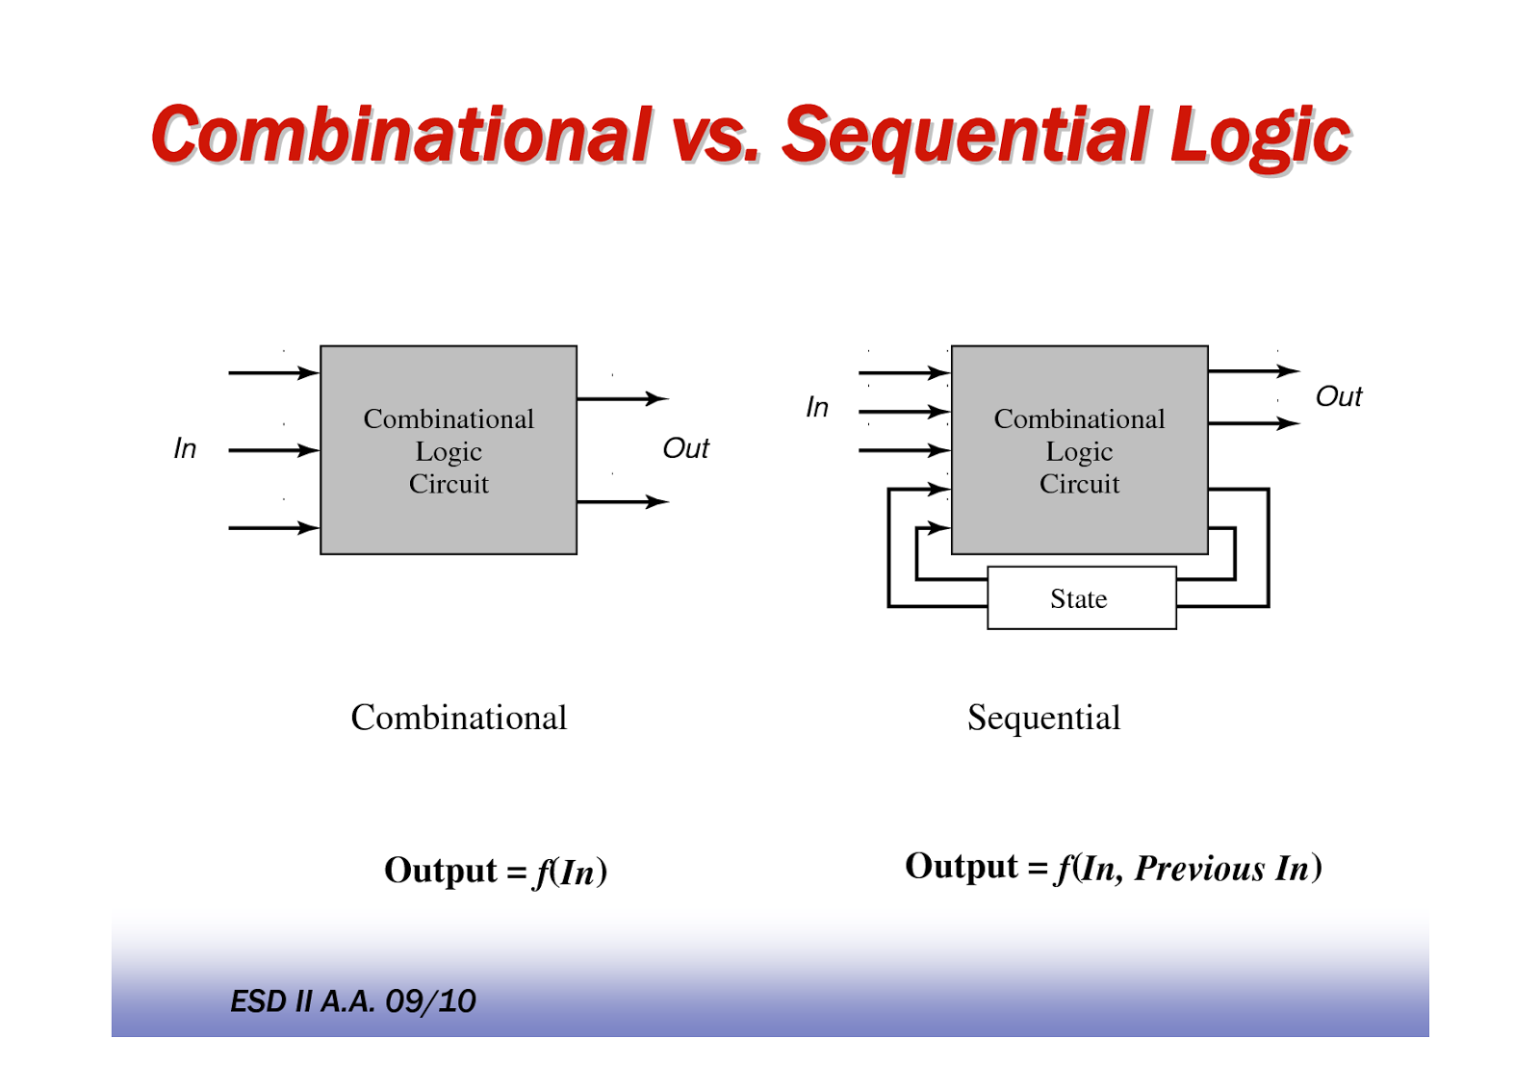
Types of Logic Circuits
Combinational
Sequential
Present combination of I/ps
Present combination of I/ps + Past sequence of I/ps
O/p depends on
Elements involved
Logic gates
Logic gates + Storage elements
Feedback present?
No
Yes

Slide 2
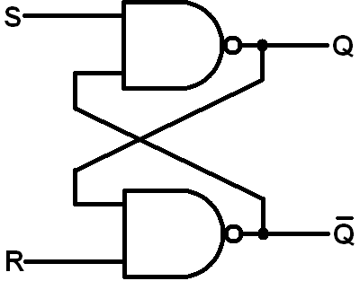
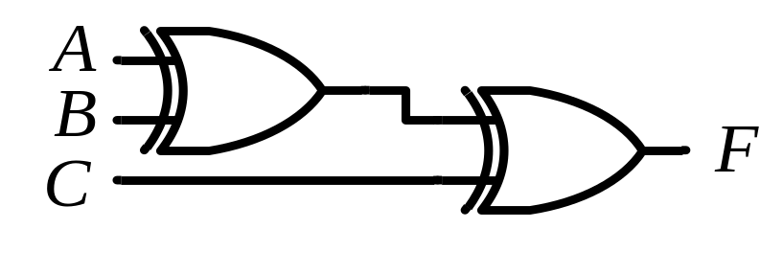
Types of Logic Circuits
Combinational
Sequential
Example
NOT for understanding

Slide 3

Combinational Circuit
Combinational
Circuit
n inputs
m outputs
•
•
•
•
•
•
✗

Slide 4
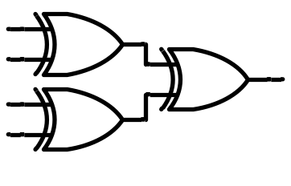
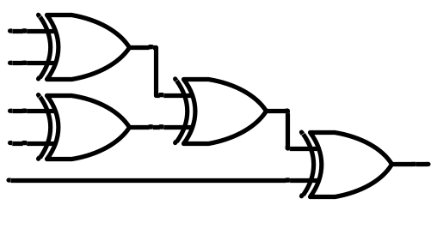
Combinational Circuit
Examples
1
0
1
0
1
0
1
0
0
Even number of ‘1’s
Parity Generator
1
0
1
0
0
Error
Check
Parity Checker

Slide 5
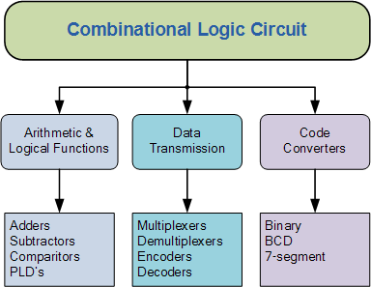
Combinational Circuit

Slide 6
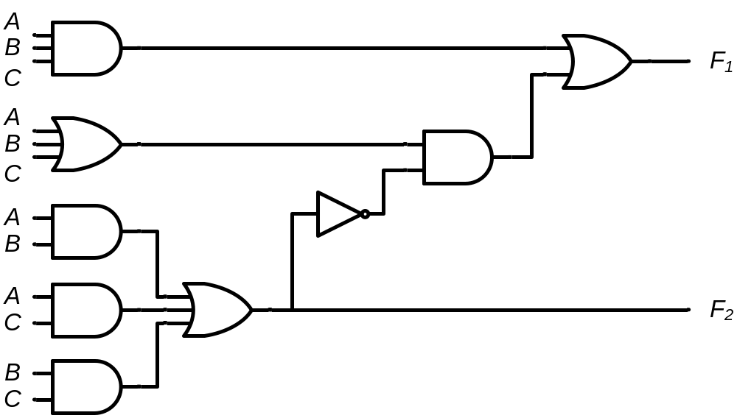
Comb. Circuits: Analysis V/s Design
Analysis
  Given a circuit, find out its function
  Function may be expressed as:
    Boolean function
    Truth table
Design
  Given a desired function/specifications, determine its circuit
  Function may be expressed as:
    Boolean function
    Truth table
?
?
?

Slide 7
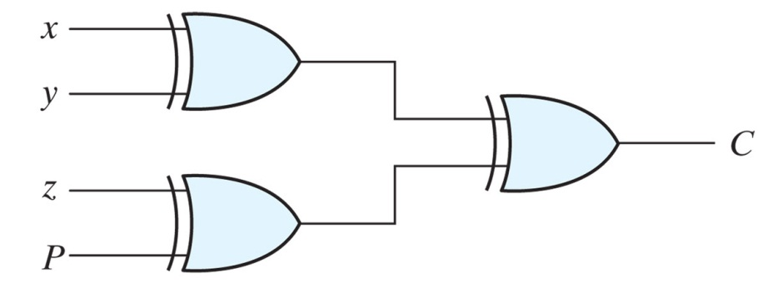

Comb. Circuits: Analysis Procedure
Two approaches:
  Boolean Function:
  Write the O/p equation describing behavior of the circuit in terms of its I/p(s)
  Truth Table:
  Create a truth table which shows relationship between circuit inputs and circuit outputs
Example

Slide 8
Analysis @ Boolean Function
Example
F₁ = ?
F₂ = ?
Label all gate O/ps that are a function of I/p variables

Slide 9
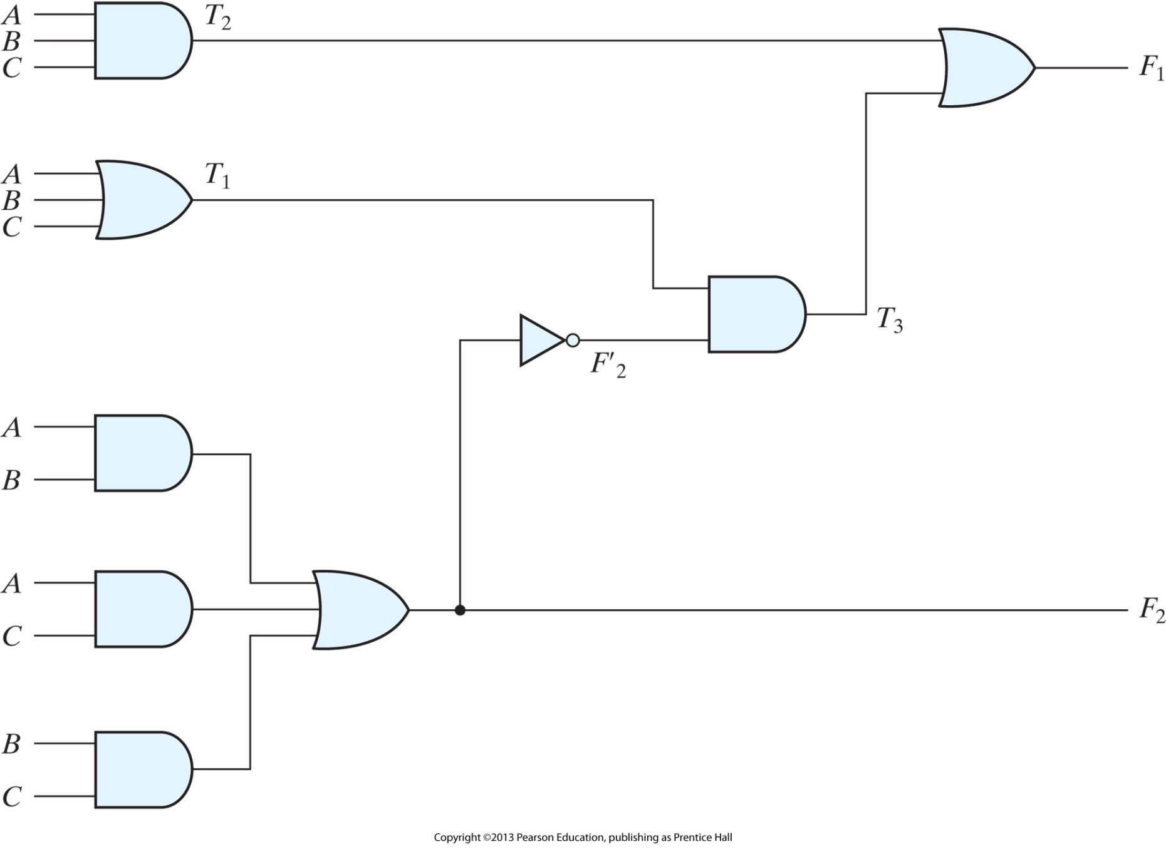
Analysis @ Boolean Function
Solution

Slide 10
Analysis @ Boolean Function
Solution
T₂ = ABC
T₁ = A+B+C
T₃ = F’₂T₁
F’₂ = (A’+B’)(A’+C’)(B’+C’)
F₂ = AB+AC+BC
Write the Boolean expressions

Slide 11
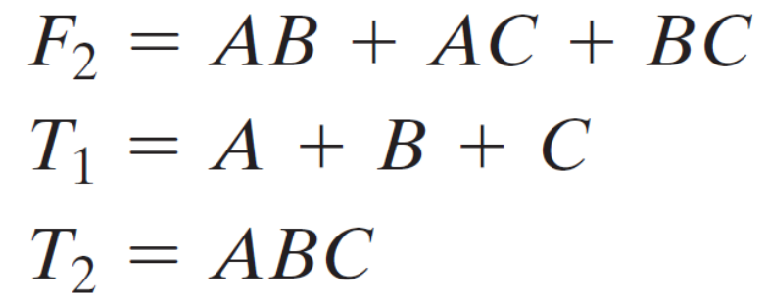
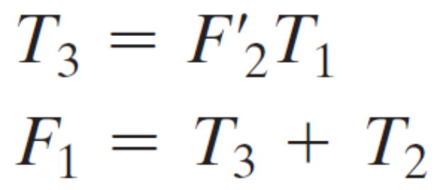
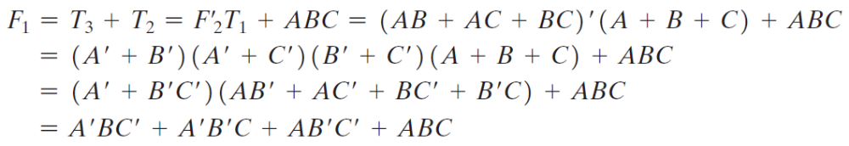
Analysis @ Boolean Function Approach
Solution

Slide 12
Comb. Circuits: Analysis Procedure
Truth Table
  Determine the number of I/p variables (n) in the circuit (2^{n} combinations). List the binary numbers from 0 to (2^{n} - 1)
  For each combination of I/p, find the O/p based on the given circuit
  Fill all the truth table

Slide 13
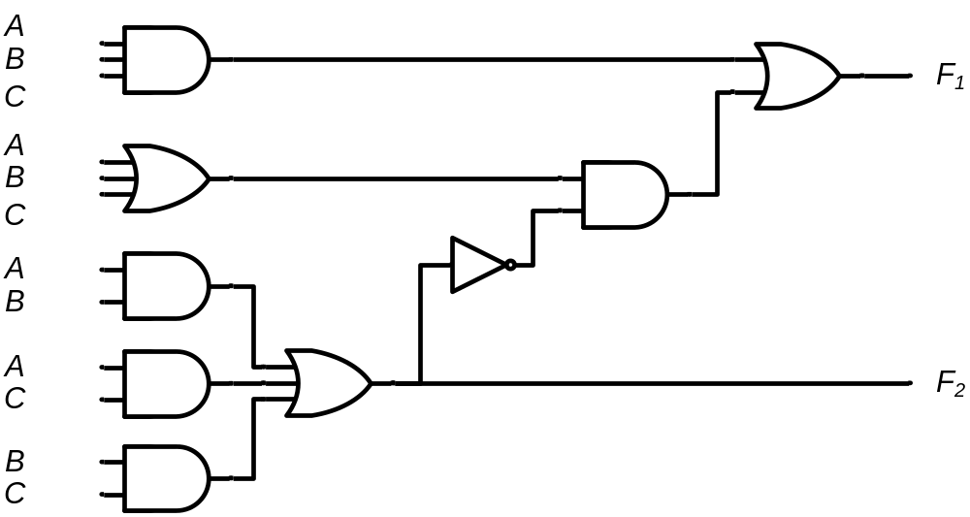
Analysis @ Truth Table Approach
A B C | F₁ | F₂
0 0 0
= 0
= 0
= 0
= 0
= 0
= 0
= 0
= 0
= 0
= 0
= 0
= 0
0 0
0
0
0
0
0
0
0
1
0

Slide 14
Analysis @ Truth Table Approach
A B C | F₁ | F₂
0 0 0 | 0 | 0
0 0 1
= 0
= 0
= 1
= 0
= 0
= 1
= 0
= 0
= 0
= 1
= 0
= 1
0
1
0
0
0
1
1 0
1
1
0

Slide 15
Analysis @ Truth Table Approach
A B C | F₁ | F₂
0 0 0 | 0 | 0
0 0 1 | 1 | 0
0 1 0
= 0
= 1
= 0
= 0
= 1
= 0
= 0
= 1
= 0
= 0
= 1
= 0
0
1
0
0
0
1
1 0
1
1
0

Slide 16
Analysis @ Truth Table Approach
A B C | F₁ | F₂
0 0 0 | 0 | 0
0 0 1 | 1 | 0
0 1 0 | 1 | 0
0 1 1
= 0
= 1
= 1
= 0
= 1
= 1
= 0
= 1
= 0
= 1
= 1
= 1
0
1
0
0
1
0
0
0 1
0
1

Slide 17
Analysis @ Truth Table Approach
A B C | F₁ | F₂
0 0 0 | 0 | 0
0 0 1 | 1 | 0
0 1 0 | 1 | 0
0 1 1 | 0 | 1
1 0 0
= 1
= 0
= 0
= 1
= 0
= 0
= 1
= 0
= 1
= 0
= 0
= 0
0
1
0
0
0
1
1
1
1 0
0

Slide 18
Analysis @ Truth Table Approach
A B C | F₁ | F₂
0 0 0 | 0 | 0
0 0 1 | 1 | 0
0 1 0 | 1 | 0
0 1 1 | 0 | 1
1 0 0 | 1 | 0
1 0 1
= 1
= 0
= 1
= 1
= 0
= 1
= 1
= 0
= 1
= 1
= 0
= 1
0
1
0
1
0
0
0
0
0 1
1

Slide 19
Analysis @ Truth Table Approach
A B C | F₁ | F₂
0 0 0 | 0 | 0
0 0 1 | 1 | 0
0 1 0 | 1 | 0
0 1 1 | 0 | 1
1 0 0 | 1 | 0
1 0 1 | 0 | 1
1 1 0
= 1
= 1
= 0
= 1
= 1
= 0
= 1
= 1
= 1
= 0
= 1
= 0
0
1
1
0
0
0
0
0
0 1
1

Slide 20
Analysis @ Truth Table Approach
A B C | F₁ | F₂
0 0 0 | 0 | 0
0 0 1 | 1 | 0
0 1 0 | 1 | 0
0 1 1 | 0 | 1
1 0 0 | 1 | 0
1 0 1 | 0 | 1
1 1 0 | 0 | 1
1 1 1
= 1
= 1
= 1
= 1
= 1
= 1
= 1
= 1
= 1
= 1
= 1
= 1
1
1
1
1
1
1
0
0
1
1 1
 |  |  |  | B
 |  | 0 | 1 | 0 | 1
A |  | 1 | 0 | 1 | 0
 |  |  | C
 |  |  |  | B
 |  | 0 | 0 | 1 | 0
A |  | 0 | 1 | 1 | 1
 |  |  | C
F₁ = AB'C‘ + A'BC‘ + A'B'C + ABC
F₂ = AB + AC + BC

Slide 21


Analysis @ Boolean Function
Solution
F₂ = 1 for any combination
that has two or three I/ps = 1
T₂ = AND of I/p Combinations
T₁ = OR of I/p Combinations
T₃ = 1 iff T₁ = 1 AND F’₂ = 1
F₁ = 1 if T₂ = 1 OR T₃ = 1
A B C
0 0 0
0 0 1
0 1 0
0 1 1
1 0 0
1 0 1
1 1 0
1 1 1
F₂
0
0
0
1
0
1
1
1
F’₂
1
1
1
0
1
0
0
0
T₂
0
0
0
0
0
0
0
1
T₁
0
1
1
1
1
1
1
1
T₃
0
1
1
0
1
0
0
0
F₁
0
1
1
0
1
0
0
1

Slide 22
Design of Combinational Circuits:
From Specifications, determine the required number of inputs and outputs
Assign a variable to each input and output
Derive a truth Table that defines the required relationship between inputs and outputs
Perform logic minimization
Draw the logic diagram

Slide 23
Example:
Design a combinational circuit with three inputs x,y,z and three outputs A,B and
C. When the binary input is 0,1,2 or 3 the binary output is two greater than the
Input. When the binary input is 4,5,6 or 7 the binary output is three less than the
Input.

Slide 24
Example:
Design a digital circuit with the output f and inputs A,B,C and D. Let the two inputs AB represent a two bit number with A as the high order bit, and CD represent another two bit number. That is, the values on AB represent four values 00 (0), 01 (1), 10 (2), and 11 (3). The output ‘ f ’ should be 1 only if the number represented by AB is greater than or equal to the number represented by CD.

Slide 25
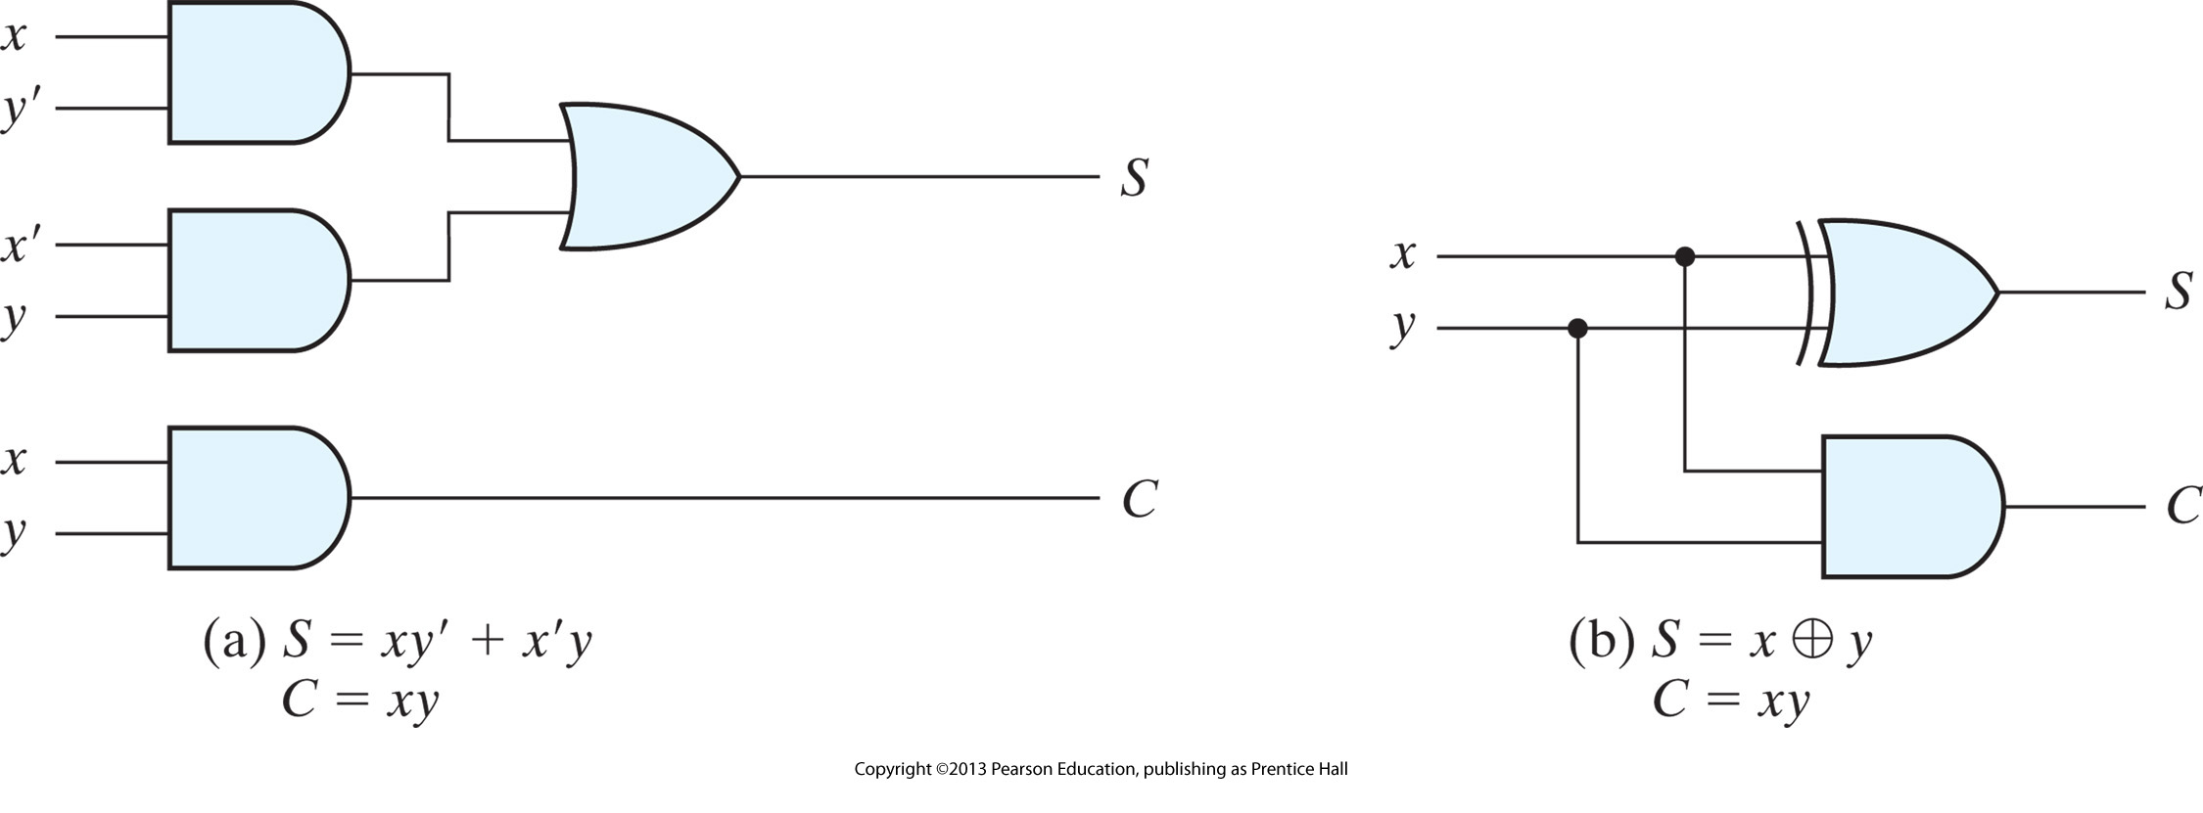
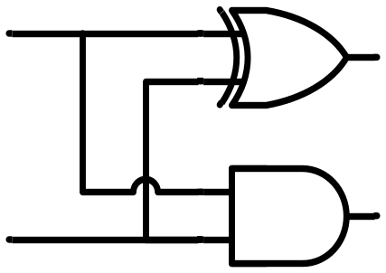
Half Adder (Design)
x
y
S
C
HA
x
+ y
───
C S
x y | C S
0 0 | 0 0
0 1 | 0 1
1 0 | 0 1
1 1 | 1 0
x
y
S
C
S represents LSB

Slide 26
Full Adder (Intro)
Background:
  Let us analyze if HA can fulfill our requirements
  Limitation of HA is that it can handle only 2 bits
  We need an adder which can add 3 bits (2 bits in question + 1 bit previous carry)
  Need for Full Adder
Example
1
1
1
1
1
1
1
1
1
1
0
1
+
1
0
1
1
1
1
0
1
0
1
0
0

Slide 27
Full Adder (Intro)
x
+ y
+ z
───
C S
x
y
z
S
C
FA
x y z | C S
0 0 0 | 0 0
0 0 1 | 0 1
0 1 0 | 0 1
0 1 1 | 1 0
1 0 0 | 0 1
1 0 1 | 1 0
1 1 0 | 1 0
1 1 1 | 1 1
 |  |  |  | y
 |  | 0 | 1 | 0 | 1
x |  | 1 | 0 | 1 | 0
 |  |  | z
S = xy'z'+x'yz'+x'y'z+xyz = x ⊕ y ⊕ z
 |  |  |  | y
 |  | 0 | 0 | 1 | 0
x |  | 0 | 1 | 1 | 1
 |  |  | z
C = xy + xz + yz

Slide 28
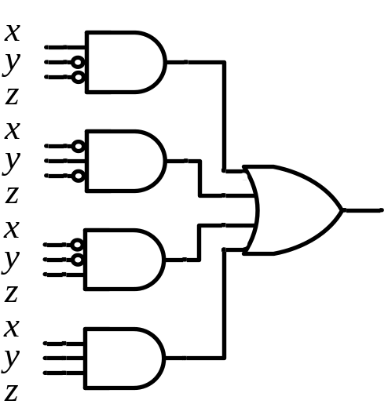
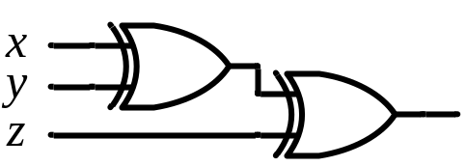
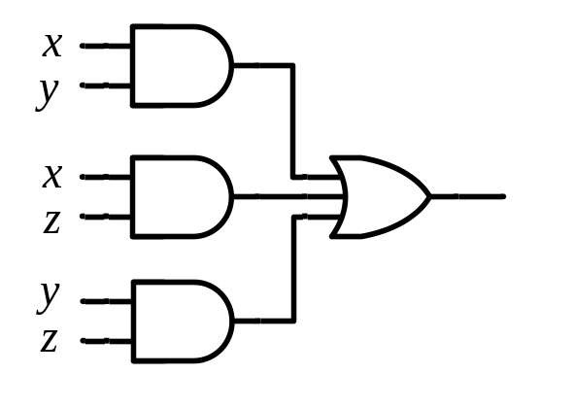
Full Adder (Design)
S = xy'z'+x'yz'+x'y'z+xyz = x ⊕ y ⊕ z
x
y
z
S
C
C = xy + xz + yz
FA
x
y
z
S
C
S
C
x
y
z

Slide 29

Full Adder using HAs (Design)
x
y
z
S
C
x
y
S_{p}
C₁
S_{p}
z
S
C₂
FA
HA 1
HA 2
x
+ y
+ z
───
C S
x
+ y
───
C₁ S_{p}
S_{p}
+ z
───
C₂ S
x y z | C S
0 0 0 | 0 0
0 0 1 | 0 1
0 1 0 | 0 1
0 1 1 | 1 0
1 0 0 | 0 1
1 0 1 | 1 0
1 1 0 | 1 0
1 1 1 | 1 1
S_{p}
HA 1
HA 2
x
y
z
C₁
C₂
S
C
C = 1 if C₁ = 1 OR C₂ = 1

Slide 30
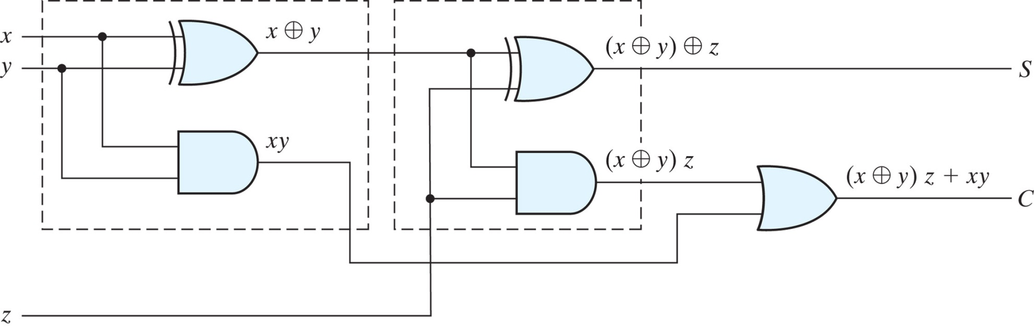
Full Adder (Design)
x
y
z
S
C
FA

Slide 31

Binary Adder
x₃x₂x₁x₀ y₃y₂y₁y₀
c₃ c₂ c₁ .
x₃ x₂ x₁ x₀
+ y₃ y₂ y₁ y₀
────────
C₄ S₃ S₂ S₁ S₀
1 HA & 3 FA
Binary Adder
C₄
C₀ =0
4 FA (C₀=0)
Carry Propagate Addition
S₃S₂S₁S₀
x₃ x₂ x₁ x₀
y₃ y₂ y₁ y₀
0
FA
FA
FA
FA
C₄ C₃ C₂ C₁
S₃ S₂ S₁ S₀

Slide 32
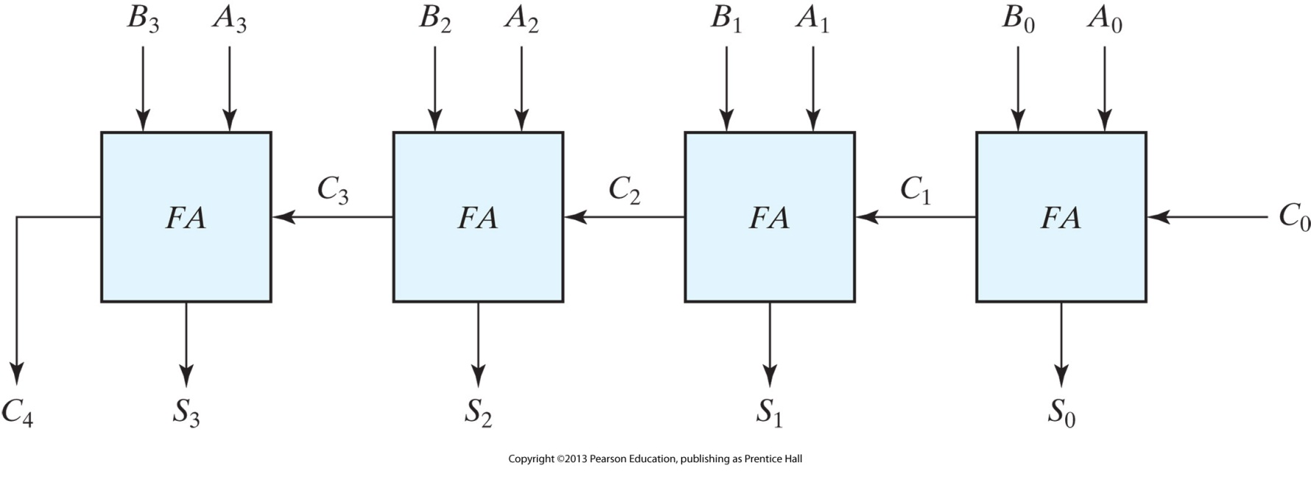
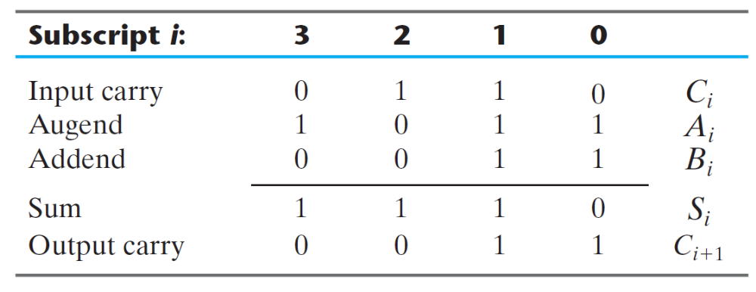
Binary Adder
C
A
R
R
Y
P
R
O
P
A
G
A
T
I
O
N
NOT available immediately
Available

Slide 33
Binary Adder (Observation)
x₃x₂x₁x₀ y₃y₂y₁y₀
Binary Adder
C₄
C₀ =0
S₃S₂S₁S₀
How many I/ps? = 9
The design of this cct. by classical method would require a truth table with 2⁹ = 512 entries
Using an iterative method of cascading a standard function, a simple implementation is possible

Slide 34
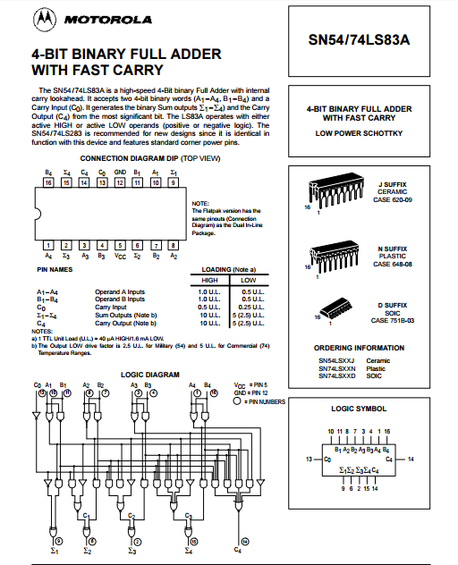
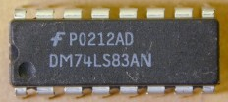
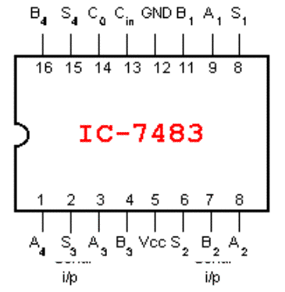
4-Bit Binary Adder (IC)

Slide 35
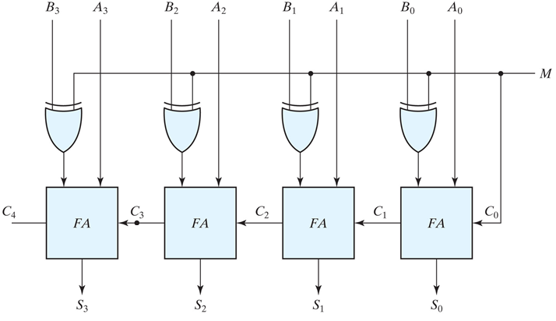
Binary Adder/Subtractor (Design)
Binary numbers in the signed-complement system are added and subtracted by the same rules as are unsigned numbers
Same H/ware. Programmer specifies (signed/unsigned) in software

Slide 36
Binary Adder/Subtractor with Overflow Detection
Overflow
  Occurs when two numbers with n bits each are added and the sum is of n+1 digits
  Happens for decimal/binary numbers unsigned/signed
  Detection of overflow for unsigned/signed is different
Overflow Detection (Unsigned numbers)
  Overflow will occur after addition.
  Carry simply indicates overflow
x₃ x₂ x₁ x₀
y₃ y₂ y₁ y₀
0
FA
FA
FA
FA
Carry
C₄ C₃ C₂ C₁
S₃ S₂ S₁ S₀

Slide 37
Detection of Overflow in Case of 2’s Complement Representation.
  Using 2’s complement representation both positive and negative numbers can be represented.
  Overflow will occur after addition if both numbers are positive or negative.
  No overflow will occur after subtraction if both numbers are either positive or negative.
  No Overflow will occur after addition if one number is positive and other is negative.

Slide 38
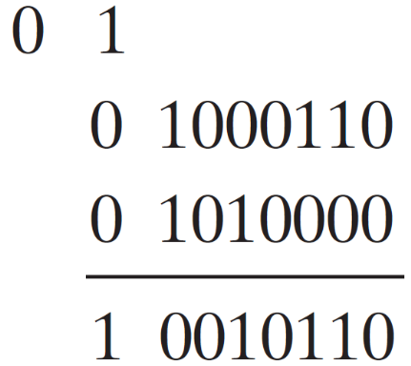
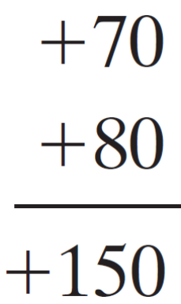
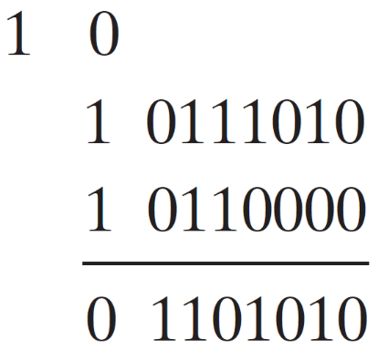
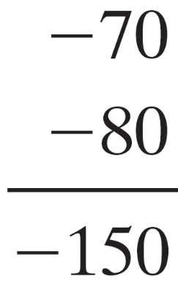
Binary Adder/Subtractor with Overflow Detection
Overflow Detection (Signed numbers)
  Consider two (8-bits) signed no. 70 and 80
Example
Correct in 9 bits (MSB =0)
-ive !!!
Correct in 9 bits (MSB =1)
+ive !!!

Slide 39

Binary Adder/Subtractor with Overflow Detection
Overflow Detection (Signed numbers)
  Cases of Overflow: How we can detect it?
Example
If the carries in the last two stages are different, an overflow occurs

Slide 40
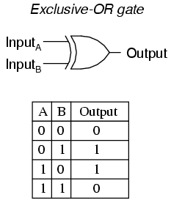

Binary Adder/Subtractor with Overflow Detection
If the carries in the last two stages are different, an overflow occurs
x₃ x₂ x₁ x₀
y₃ y₂ y₁ y₀
0
FA
FA
FA
FA
Overflow
C₄ C₃ C₂ C₁
S₃ S₂ S₁ S₀

Slide 41
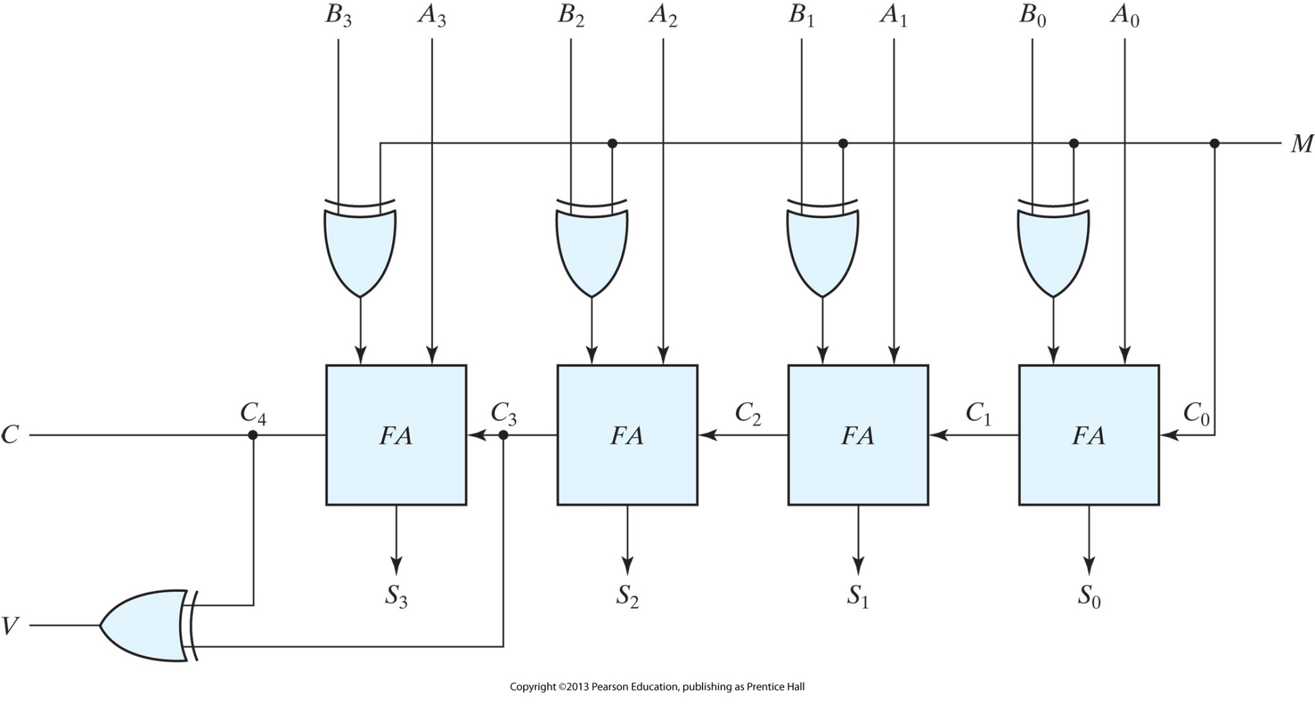
Binary Adder/Subtractor with Overflow Detection

Slide 42
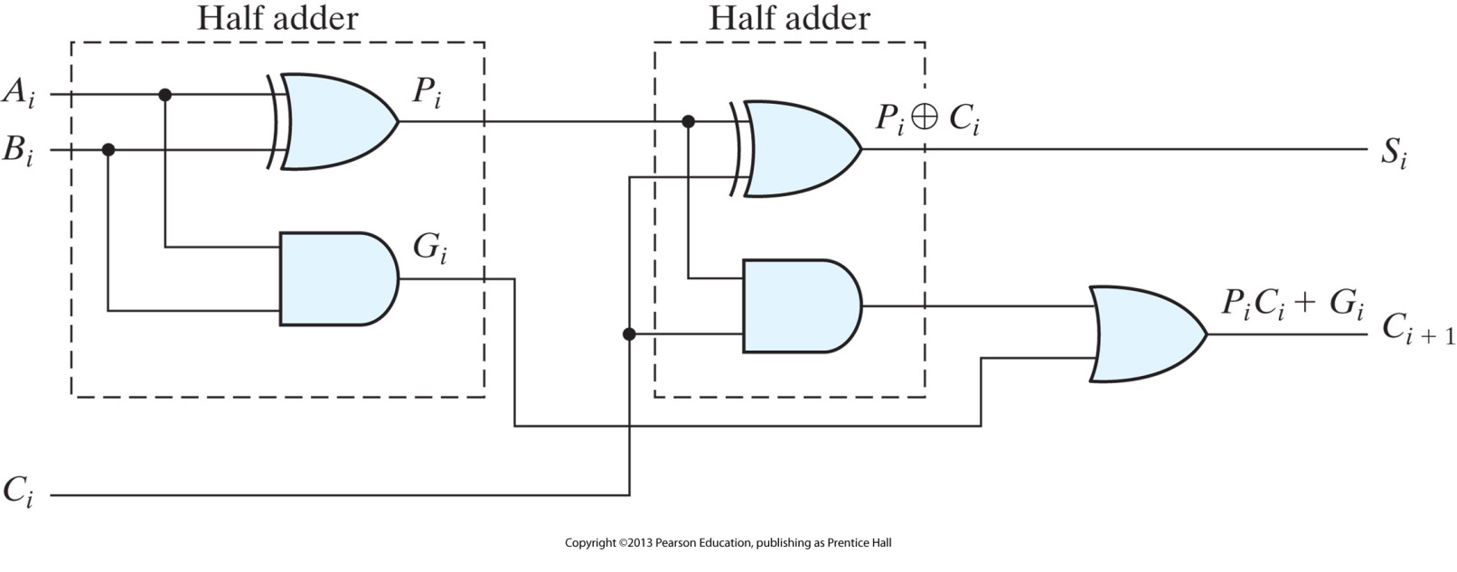




Carry Lookahead Generator
FA Adder with different labels for convenience
G_{i} = carry Generate. It produces a carry of 1 when both A_{i} and B_{i} =1
P_{i} = carry Propagate. It determines whether a carry from stage i will propagate into stage i + 1

Slide 43

Carry Lookahead Generator
Known Variables:
If C_{i} are known, then S_{i} is known
A_{i} , B_{i}
P_{i}
C_{i} can be found once expressed in known variables
G_{i}
I/p carry

Slide 44


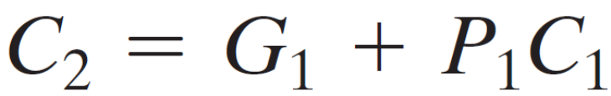
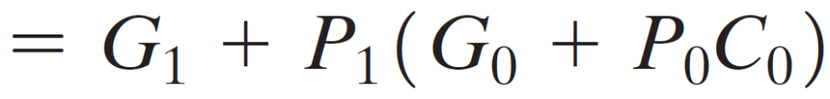

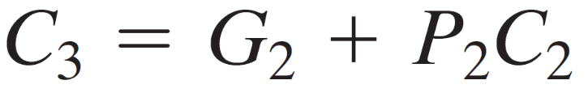


Carry Lookahead Generator

Slide 45
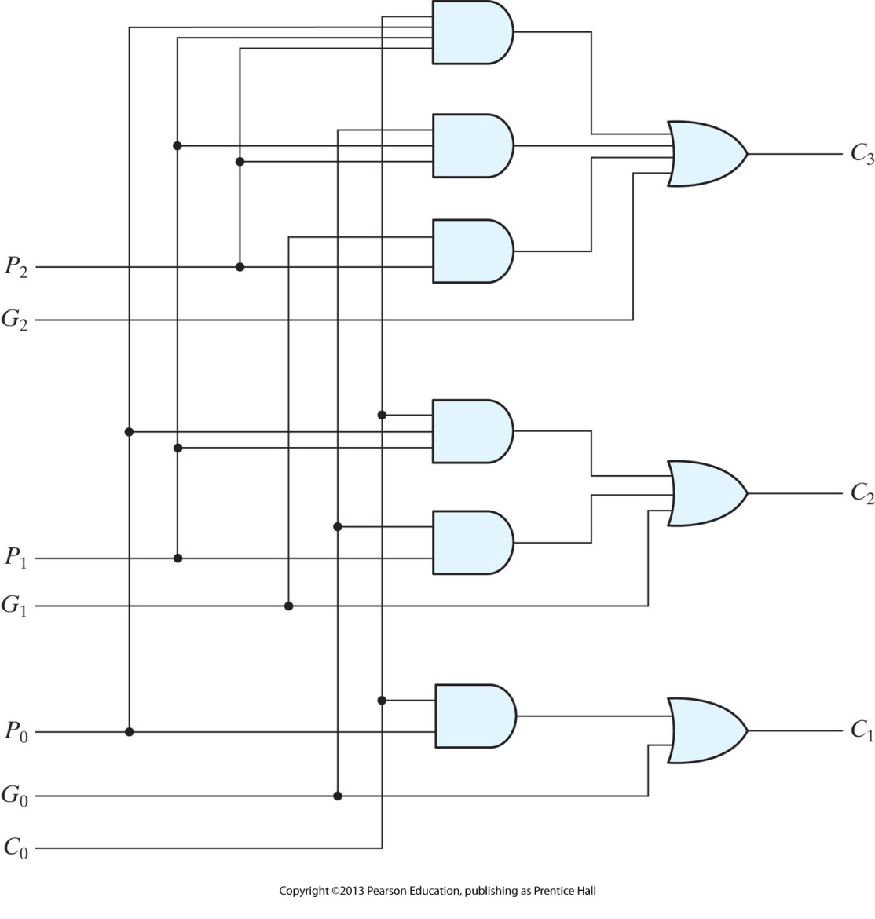
Carry Lookahead Generator
Carry Generator
P₂
G₂
C₃
C₂
C₁
P₁
G₁
P₀
G₀
C₀

Slide 46
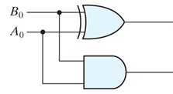

1-bit Adder with Carry Lookahead
Carry Generator
P₀
S₀
G₀
C₀
C₀

Slide 47
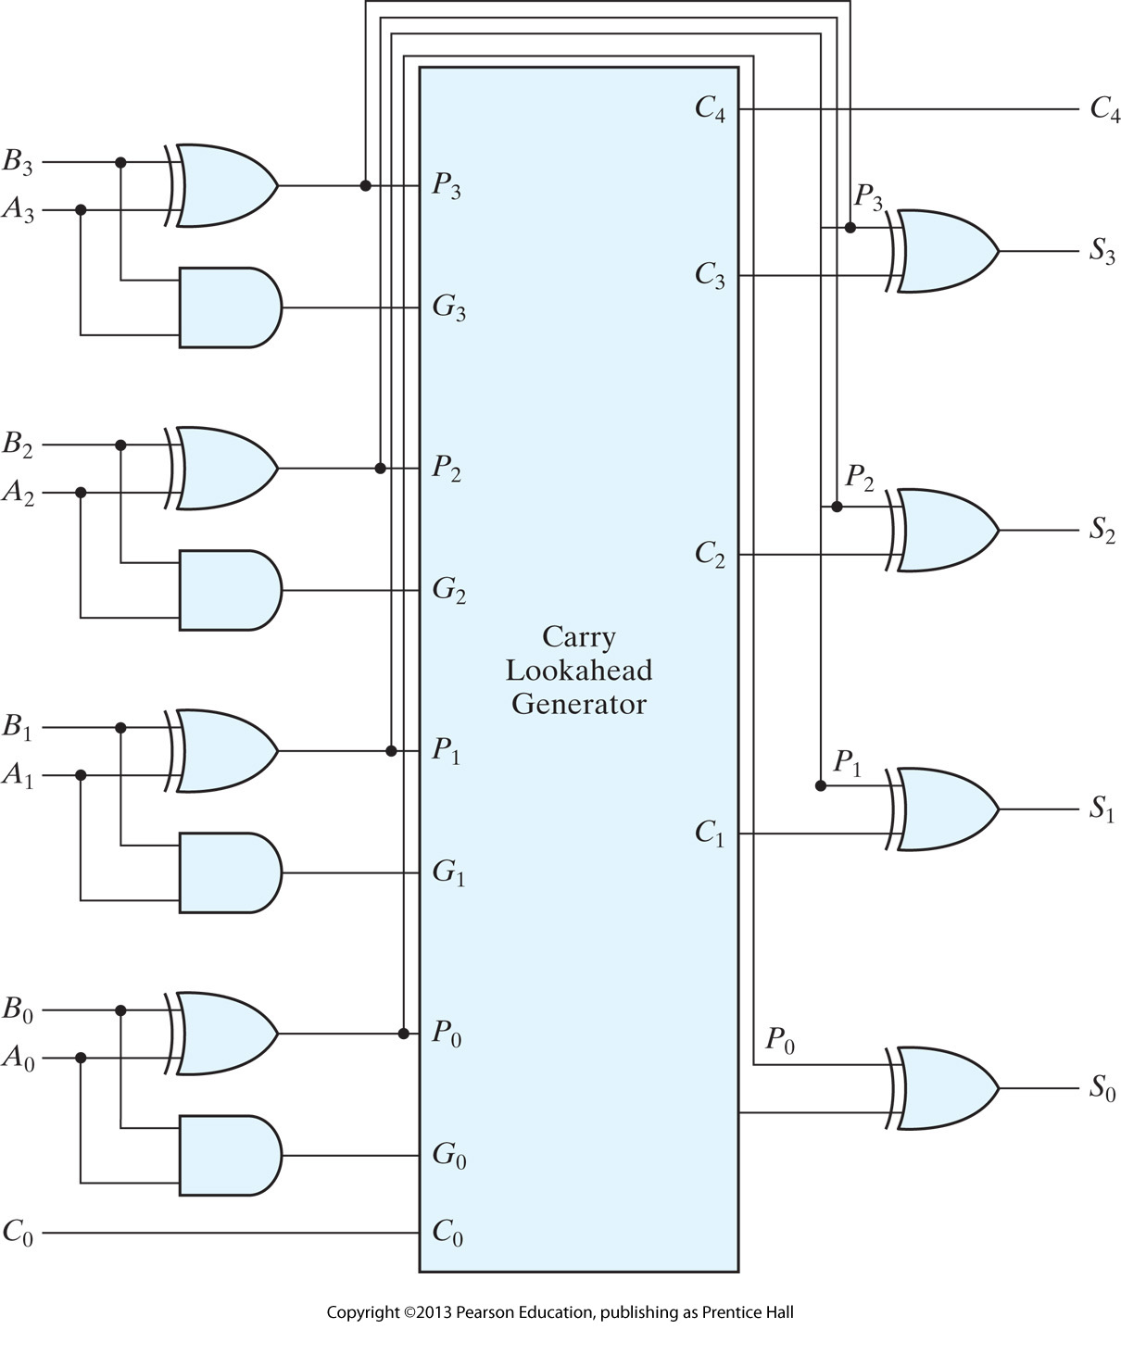

4-Bit Adder with Carry Lookahead
c₃ c₂ c₁ .
A₃ A₂ A₁ A₀
+ B₃ B₂ B₁ B₀
────────
C₄ S₃ S₂ S₁ S₀
Delay ↓↓↓
H/ware Complexity
↑↑↑

Slide 48
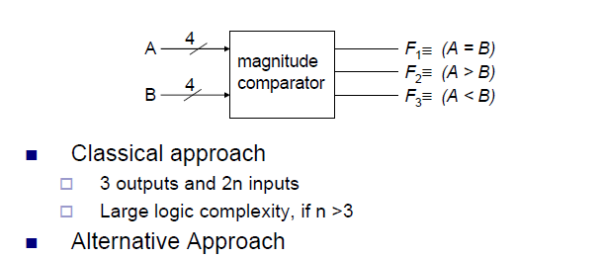
Magnitude Comparator:

Slide 49
Magnitude Comparator:
A= A₃A₂A₁A₀
B= B₃B₂B₁B₀
Writing the Boolean Expression for A=B:
X_{i}= (A’_{i}B_{i} + A_{i}B’_{i} )’
[A=B] = X₃X₂X₁X₀
Writing the Boolean Expression for A>B and A<B:
(A>B) = A₃B₃'+x₃A₂B₂'+x₃x₂A₁B₁'+x₃x₂x₁ A₀B₀'
  (A<B) = A₃'B₃+x₃A₂'B₂+x₃x₂A₁'B₁+x₃x₂x₁ A₀'B₀

Slide 50
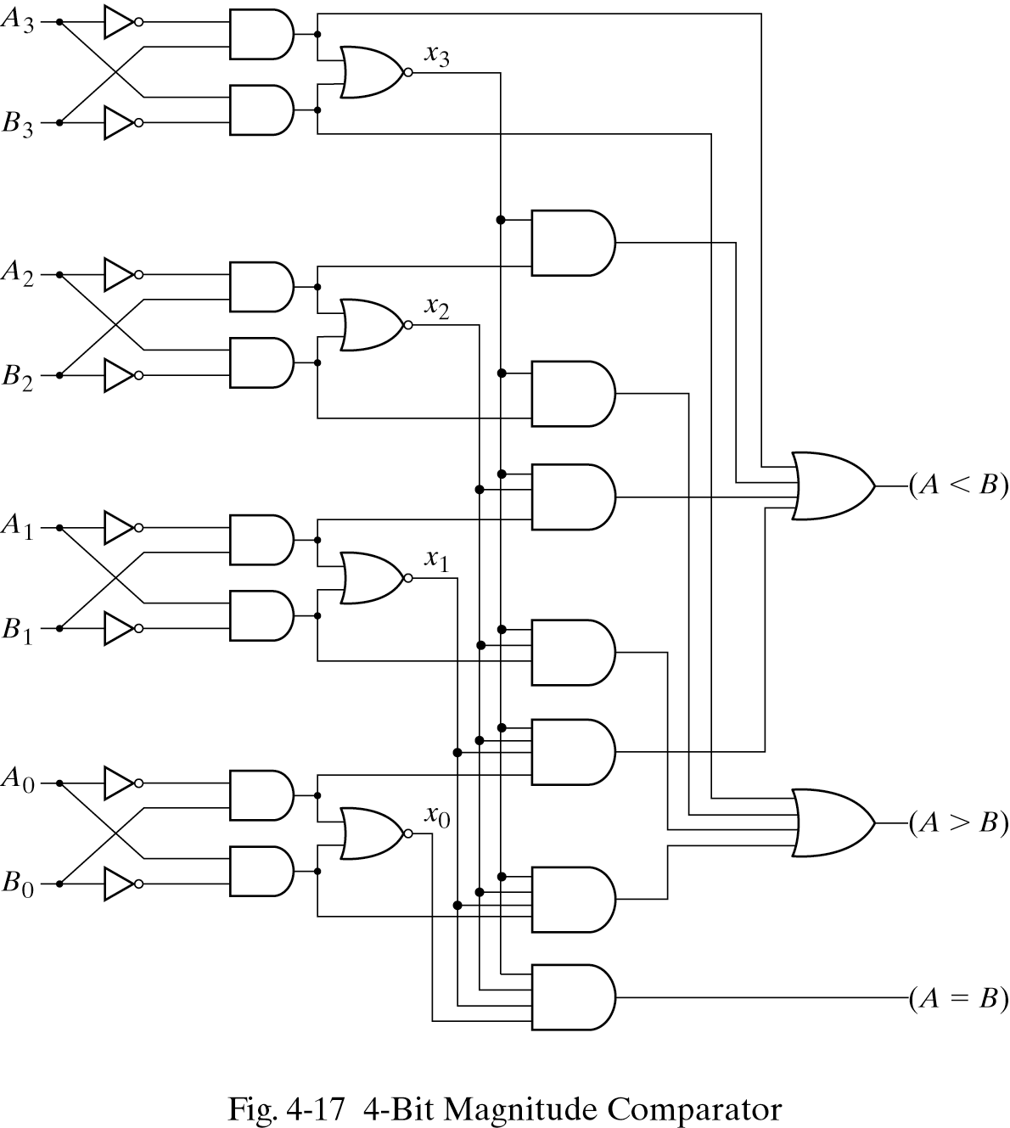
Magnitude Comparator:

